Slide 1
Warm Up
Tell whether the ratios form a proportion.
Find the missing number.

Slide 2
Translations
I can:
Define and identify translations.
Understand prime notation to describe an image after a translation.
I can describe the changes occurring to the x and y coordinates of a figure after a translation.
Vocabulary:
Transformations
Translations
Congruent Figures
Parallel lines

Slide 3
Transformations
change the position of a shape on a coordinate plane.
*What that really means is that a shape is moving from one place to another.

Slide 4
Translation (Slide)
The action of sliding a figure in any direction.
*We use an arrow to represent the direction of the slide.

Slide 5
A translation does not need to be in a vertical or horizontal direction.
It can also be in a diagonal direction.

Slide 6
Translation on Lines
The size stays the same, the object is just slid to a new location.
The lines are considered parallel lines- lines are parallel if they lie in the same plane, and are the same distance apart over their entire length.

Slide 7
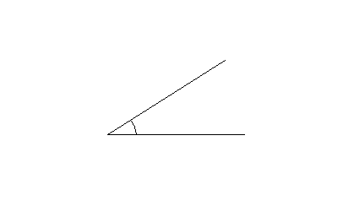
Translation on Angles
The angle degree stays the same, the angle is just slid to a new location.

Slide 8
Congruent Figures
Figures with the same size and shape.

Slide 9
Click the Octagon to see Translation.
Translation

Slide 10
Translation
Notes:
Translation

Slide 11
Translation
Notes:
Translation.

Slide 12
Prime Notation
Way to label an image after a transformation.
Example:
A B A’ B’
(original before transformation) (image after transformation)
A’ is read as “A prime.”

Slide 13
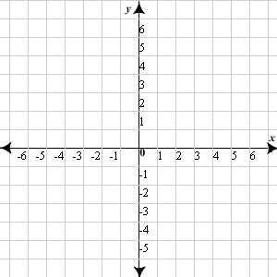
Coordinate Plane
A translation across the y-axis

Slide 14
Coordinate Plane
A translation across the x-axis

