Slide 1
Unit 17: Dilations
I can:
I can define dilations as a reduction or enlargement of a figure.
I can identify the scale factor of the dilation.
Vocabulary:
Dilations
Center of Dilation
Similar
Scale Factor
Enlargement
Reduction

Slide 2
Dilations (Shrink or Enlargement)
A transformation in which a figure is made larger or smaller with respect to a fixed point called the center of dilation.

Slide 3
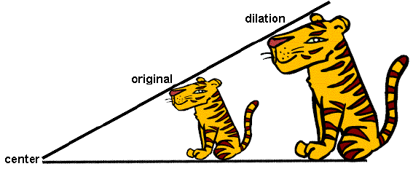
Center of Dilation
In a dilation, it is a fixed point that a figure is enlarged or reduced with respect to it.

Slide 4
Similar
The original figure and its image have the same shape but a different size.

Slide 5
Scale Factor
The ratio of the side lengths of the image to the corresponding side lengths of the original figure.

Slide 6
To dilate a figure in the coordinate plane, multiply the coordinates of each vertex by a scale factor.
We will represent the scale factor with the variable k.

Slide 7
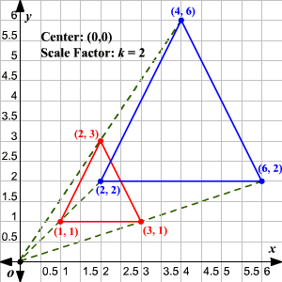
Enlargement
When k>1
Examples:
Scale factor = 3
Scale factor = 8
Scale factor = 11

Slide 8
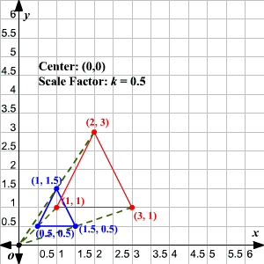
Reduction
When 0<k<1
Examples:
Scale factor = 1/3
Scale factor = 5/6
Scale factor = 9/10

Slide 9
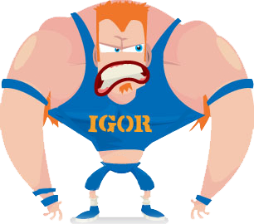
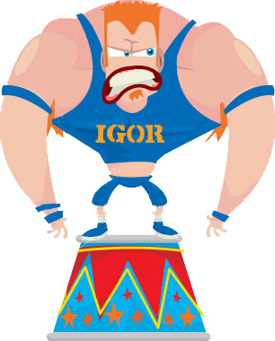
Scale Factor and Center of Dilation
Here we have Igor. He is 3 feet tall and the greatest width across his body is 2 feet.
He wishes he were 6 feet tall with a width of 4 feet.
His center of dilation would be where the length and greatest width of his body intersect.
He wishes he were larger by a scale factor of 2.
Notes:
Scale Factor - change in size of the object.
Center of Dilation – the very central point of the object.

Slide 10
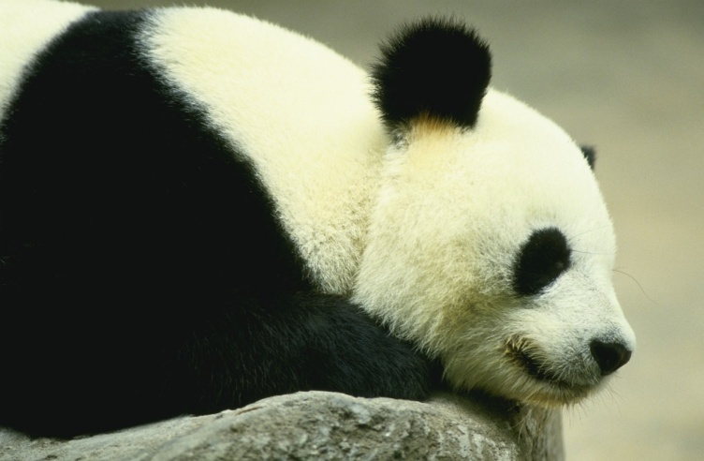
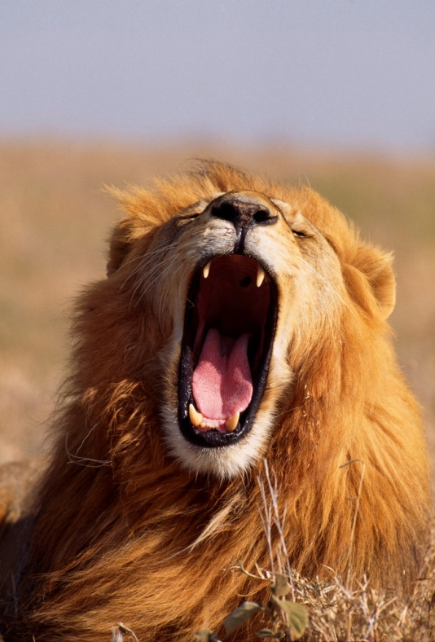
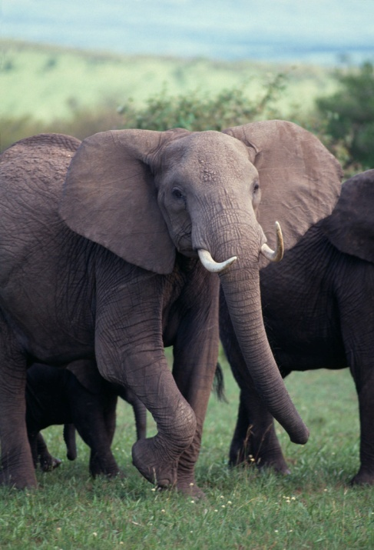
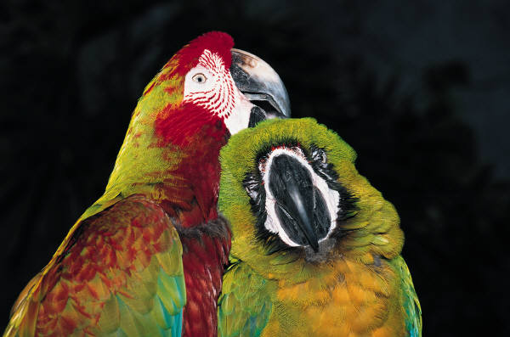
Are the following enlarged or reduced??
C
A
Scale factor of 1.5
D
Scale factor of 3
B
Scale factor of 0.75
Scale factor of 1/5
Notes:
Discuss slides before clicking for the answer.
A is enlarged.
B is reduced.
C is enlarged.
D is reduced.

